Slide 1

Character Array in C
Strings and Char operations for embedded systems

Slide 2
Char
Every printable character is represented by its ASCII Code
01
ASCII code is max 7 bit long
02
unsigned or signed char can be used
03
An array of char variables is also called string
04

Slide 3

Printing a char
%c can be used with printf to print a single char
putchar can be used to print a single char
%s can be used with printf to print a string
Puts can be used to print a string

Slide 4
How char is scanned
When we scan a char using %c directive, then the decimal equivalent of the character that you entered is saved in the variable
When you print it using %c directive, then the decimal number is “AS IS” sent to print buffer, and since it resemebles an actual ascii code of a letter, the letter is printed.

Slide 5
Scan ( input a char)
Single char can be input with scanf function using %c
single char can be input with getchar function
String can be input with scanf function using %s
String can be input with gets function
None of scnaf / printf / getchar / gets / puts / putchar functions are available in Embedded Systems

Slide 6
Character Comparison
char my = ‘a’
if(my == ‘a’)
{
}

Slide 7
String Comparison
char a[10] = “welcome”
if(strcmp(a, “welcome”) == 0)
{
}

Slide 8
String Functions in C ( also available in all embedded systems)
Sr.No. | Function & Purpose
1 | strcpy(s1, s2); Copies string s2 into string s1.
2 | strcat(s1, s2); Concatenates string s2 onto the end of string s1.
3 | strlen(s1); Returns the length of string s1.
4 | strcmp(s1, s2); Returns 0 if s1 and s2 are the same; less than 0 if s1<s2; greater than 0 if s1>s2.
5 | strchr(s1, ch); Returns a pointer to the first occurrence of character ch in string s1.
6 | strstr(s1, s2); Returns a pointer to the first occurrence of string s2 in string s1.

Slide 9
sprintf
Convert float/int to string in Embedded C

Slide 10
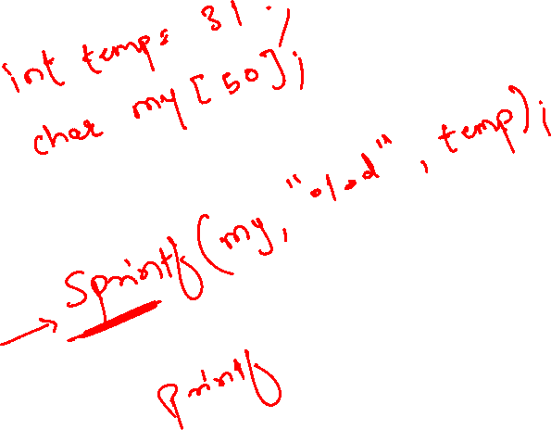

Slide 11
Pointers in C
Very important for Embedded Systems

Slide 12
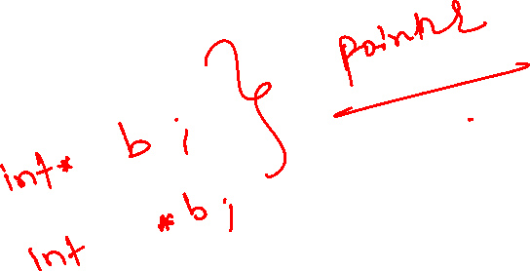
Pointer Syntax in Declaration
int *a;
int *p;

Slide 13
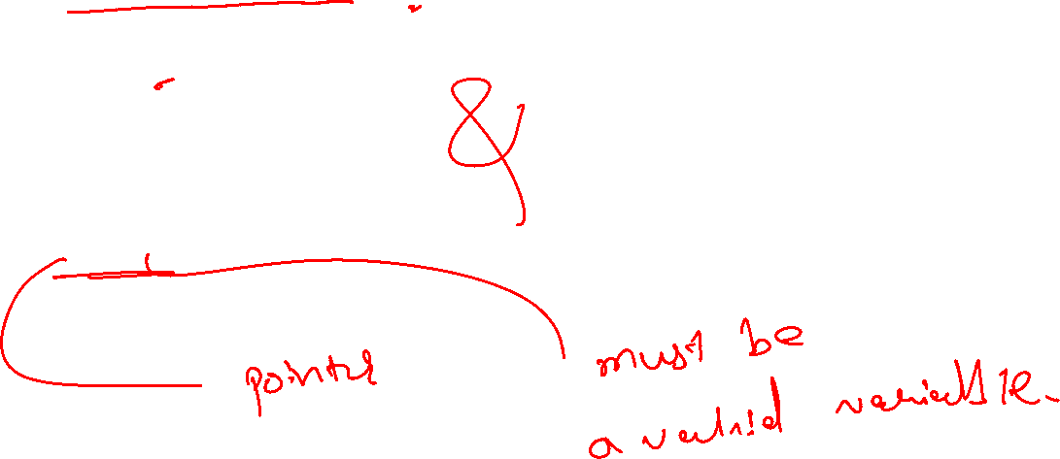
Assigning addresses to Pointers “Address of”(&) Operator
int *p
int c;
c = 5;
p = &c;

Slide 14
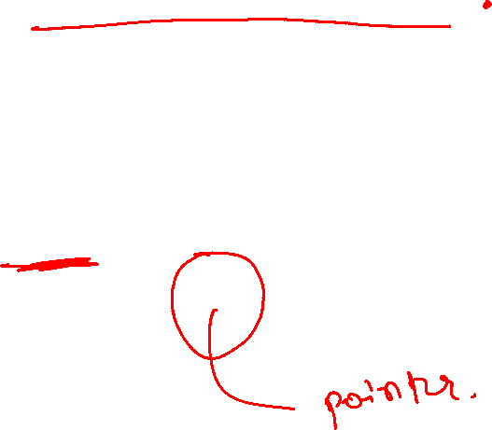
Get Value of Thing Pointed by Pointers “Value at Address”(*) Operator
int *p;
int c;
c = 5;
p = &c;
printf("%d", *p); // Output: 5

Slide 15
Functions in C

Slide 16
Functions
Codes that need to repeat
Function without any argument
Function with one or more argument
Function that returns one argument

Slide 17
Function Syntax
Function_datatype function_name(arguments)
{
return arguments_if_any
}

